Slide 1
U204206B-Digital Electronics – Spring 2022
Introduction to Sequential Logic, Basic Storage Element
dd_vahid_slides_ch3
Digital-Electronics-Module-05
教材第5章

Slide 2

Sequential Logic Design
Introduction
3.1
Sequential circuit
1
a
Combinational digital circuit
1
Output depends not just on present inputs (as in _{b} ⁰
combinational circuit), but on past sequence of inputs
Stores bits, also known as having “state”
F
□ Simple example: a circuit that counts up in binary
1
Sequential digital circuit
a
? _{F}
_{b} 0
Must know sequence of past inputs to know output
3

Slide 3


Sequential Logic Design
Example Needing Bit Storage
3.2
Call button
Cancel button
Blue light
Bit Storage
Flight attendant call button
Press call: light turns on
Stays on after button released
Press cancel: light turns off
Logic gate circuit to implement this?
Call Q
Cancel
1. Call button pressed – light turns on
Call button
Cancel button
Blue light
Bit Storage
a
2. Call button released – light stays on
a
Doesn’t work. Q=1 when Call=1, but doesn’t stay 1 when Call returns to 0
Call button
Cancel button
Blue light
Bit Storage
Need some form of “feedback” in the circuit
3. Cancel button pressed – light turns off
4
Notes:
Attendant 乘务员

Slide 4




Sequential Logic Design
First attempt at Bit Storage
We need some sort of feedback
Does circuit on the right do what we want?
No: Once Q becomes 1 (when S=1), Q stays 1 forever – no value of S can bring Q back to 0
S
Q
t
S 1
0
S 1
1
_{1 Q} S 0
S 1
Q
₁ Q
₁ Q
0
1
a
0
t
t
t
t
_{S} 1
0
_{t} 1
0
_{Q} 1
0
5

Slide 5


Sequential Logic Design
Bit Storage Using an SR Latch
S (set)
SR latch
Does the circuit to the right, with cross-coupled NOR gates, do what we want?
□ Yes! How did someone come up with that circuit? Maybe just trial and error, a bit of insight...
Q
R (reset)
S=0
S=0 S=1
S=0
t
t
t
t
Recall…
0
1
1
0
0
0
0
0 1
1
1
1
1
0
0
1
X
0 _{Q}
0 _{Q}
1
Q
1
Q
0
R=1
R=0
R=0
R=0
_{S} 1
0
_{R} 1
0
a
_{t} 1
0
_{Q} 1
0
6

Slide 6

Sequential Logic Design
Simple Example Using SR Latch for Bit Storage
SR latch can serve as bit storage in previous example of flight-attendant call button
Call=1 : sets Q to 1
Q stays 1 even after Call=0
Cancel=1 : resets Q to 0
Call button
Cancel button
Blue light
Bit Storage
Call but t on
S
But, there’s a problem...
Blue light
Cancel
but t on
Q
R
7

Slide 7
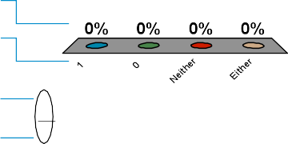
Sequential Logic Design
SR Latch
What value with the output Q have at the indicated time?
1. 1
2. 0
3. Neither
4. Either
1
0
1
0
1
0
1
0
S=1
t=0
S=0
t=??
S
R
Q=0
Q=??
t
R=1
R=0
??
Q
8

Slide 8
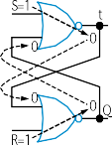
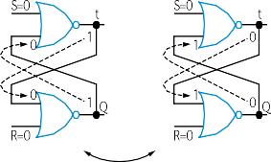
Sequential Logic Design
Problem with SR Latch
Problem
□ If S=1 and R=1 simultaneously, we don’t know what value Q will take
Q may oscillate. Then, because one path will be slightly longer than the other, Q will eventually settle to 1 or 0 – but we don’t know which.
9

Slide 9









Sequential Logic Design
Solution: Level-Sensitive SR Latch
Add enable input “C” as shown
Only let S and R change when C=0
Enure circuit in front of SR never sets SR=11, except briefly due to path delays
Change C to 1 only after sufficient time for S and R to be stable
When C becomes 1, the stable S and R value
Level-sensitive SR latch S1
S
C
Q
R
R1
passes through the two AND gates to the SR
latch’s S1 R1 inputs.
S
Q’
C
Q
R
Level-sensitive SR latch
Though SR=11 briefly...
S
1
S
X
S1
0
_{R} 1
Level-sensitive SR latch symbol
0
Clk ^{C}
1
a
C ₀
1
S1 ₀
Q
R
R1
Y
1
R1
0
...S1R1 never = 11
10

Slide 10
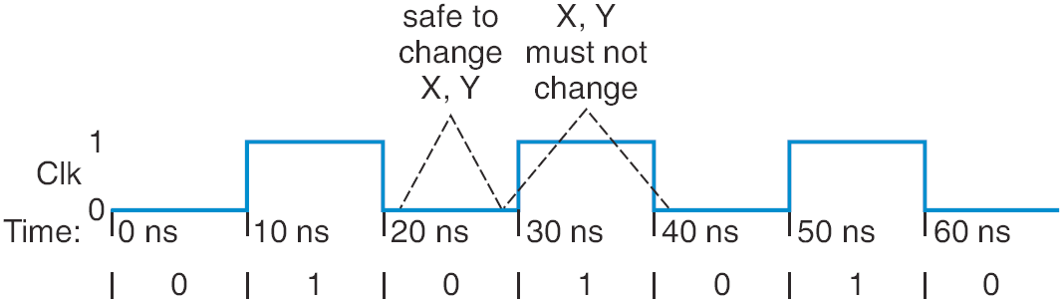
Sequential Logic Design
Clock Signals for a Latch
How do we know when it’s safe to set C=1?
Most common solution –make C pulse up/down
C=0: Safe to change X, Y
C=1: Must not change X, Y
We’ll see how to ensure that later
Clock signal -- Pulsing signal used to enable latches
Because it ticks like a clock
Sequential circuit whose storage components all use clock signals: synchronous circuit
Most common type
Asynchronous circuits – important topic, but left for advanced course
Level-sensitive SR latch S
S1
X
Clk
C
Q
R
R1
Y
11

Slide 11
Sequential Logic Design
Clock Signal Terminology
Clock period
Time interval between pulses
Above signal: period = 20 ns
Clock cycle
Oone such time interval
Above signal shows 3.5 clock cycles
Clock frequency
1/period
Above signal: frequency = 1 / 20 ns = 50 MHz
1 Hz = 1/s
Freq | Period
100 GHz | 0.01 ns
10 GHz | 0.1 ns
1 GHz | 1 ns
100 MHz | 10 ns
10 MHz | 100 ns
12

Slide 12



Sequential Logic Design
Level-Sensitive D Latch
SR latch requires careful design to ensure SR=11 never occurs
D latch relieves designer of that burden
□ Inserted inverter ensures R always opposite of S
D latch
D
S
C
Q
R
D Q’
C Q
D latch symbol
13

Slide 13
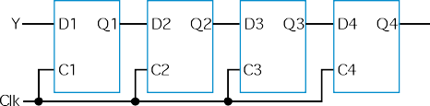
Sequential Logic Design
Problem with Level-Sensitive D Latch
D latch still has problem (as does SR latch)
When C=1, through how many latches will a signal travel?
Depends on for how long C=1
Clk_A -- signal may travel through multiple latches
Clk_B -- signal may travel through fewer latches
Hard to pick C that is just the right length
Can we design bit storage that only stores a value on the rising edge of
a clock signal?
rising edges
Clk
14

Slide 14

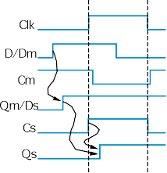

Sequential Logic Design
D Flip-Flop
Flip-flop: Bit storage that stores on clock edge, not level
One design -- master-servant
Two latches, output of first goes to input of second, master latch has inverted clock signal
So master loaded when C=0, then servant when C=1
When C changes from 0 to 1, master disabled, servant loaded with value that was at D just before C changed -- i.e., value at D during rising edge of C
rising edges
Clk
Note: Hundreds of different flip- flop designs exist
D flip-flop
D latch
Dm Qm
Cm
master
D latch
Ds Qs’
Cs Qs servant
D
Q’
Q
Clk
15

Slide 15

Sequential Logic Design
D Flip-Flop
D
Q’
Q
D
Q’
Q
Internal design: Just invert servant clock rather than master
The triangle means clock input, edge triggered
Symbol for rising-edge triggered D flip-flop
Symbol for falling-edge triggered D flip-flop
rising edges
falling edges
Clk
Clk
16

Slide 16

Sequential Logic Design
D Latches and D Flip-Flops
What is the final value of the output Q given the following timing diagram? 1. 1
2. 0
3. Neither
4. 5
D Q’
Q
Clk
D
17

Slide 17

Sequential Logic Design
D Latches and D Flip-Flops
What is the final value of the output Q given the following timing diagram? 1. 1
2. 0
3. Neither
4. -2
D Q’
Q
Clk
D
18

Slide 18

Sequential Logic Design
D Flip-Flop
Solves problem of not knowing through how many latches a signal travels when C=1
In figure below, signal travels through exactly one flip-flop, for Clk_A or Clk_B
Why? Because on rising edge of Clk, all four flip-flops are loaded simultaneously -- then all four no longer pay attention to their input, until the next rising edge. Doesn’t matter how long Clk is 1.
D4 Q4
Y
D1 Q1
D2 Q2
D3 Q3
Two latches inside each flip-flop
Clk
Clk_A
Clk_B
19

Slide 19
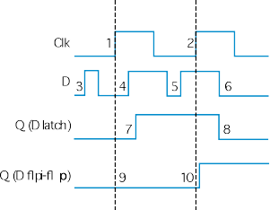
Sequential Logic Design
D Latch vs. D Flip-Flop
Latch is level-sensitive: Stores D when C=1
Flip-flop is edge triggered: Stores D when C changes from 0 to 1
Saying “level-sensitive latch,” or “edge-triggered flip-flop,” is redundant
Two types of flip-flops -- rising or falling edge triggered.
Comparing behavior of latch and flip-flop:
20

Slide 20
Sequential Logic Design
Bit Storage Summary
SR latch
Level-sensitive SR latch
D latch
D flip-flop
D | D latch Dm Qm Cm master |  |  | D latch Ds Qs’ Cs Qs servant | Q’
 |  |  |  |  | Q
Clk
S (set)
S
S1
D
S
C
C
Q
R
Q
Q
R (reset)
R1
R
Feature: S=1 sets Q to 1, R=1 resets Q to 0. Problem: SR=11 yield undefined Q.
Feature: S and R only have effect when C=1. We can design outside circuit so SR=11 never happens when C=1.
Problem: avoiding SR=11 can be a burden.
Feature: SR can’t be 11 if D is stable before and while C=1, and will be 11 for only a brief glitch even if D changes while C=1. Problem: C=1 too long propagates new values through too many latches: too short may not enable a store.
Feature: Only loads D value present at rising clock edge, so values can’t propagate to other flip-flops during same clock cycle. Tradeoff: uses more gates internally than D latch, and requires more external gates than SR – but gate count is less of an issue today.
21

Slide 21
Sequential Logic Design
Basic Register
Typically, we store multi-bit items
e.g., storing a 4-bit binary number
Register: multiple flip-flops sharing clock signal
From this point, we’ll use registers for bit storage
No need to think of latches or flip-flops
But now you know what’s inside a register
22

